Slide 1
TCP/IP Protocol Suite: Application Layer
Faculty: Dr. Asif Uddin Khan
Assistant Professor
KIIT University

Slide 2
Acknowledgement
These slides are taken (as it is or with some modifications) from various resources including -
Computer Networking: A top-down approach (Book and Slides) by Jim Kurose and Keith Ross
Data Communication and Networking with TCP/IP Protocol Suite (Book and Slides) by Behrouz A. Forouzan

Slide 3
What we have studied so far...
What is a Computer Network?
Network Criteria
Network Topologies
Types of Computer Networks
Structure of the Internet
Circuit Switching
Packet Switching
Delays in Packet Switched Networks
Throughput
TCP / IP Protocol Suite
OSI Model
Analog and Digital Signals
Attributes of Analog Signals
Composite Signals
Attributes of Digital Signals
Transmission of Digital Signals
Multiplexing
Digital Transmission
Digital to Digital Conversion
Analog to Digital Conversion
Analog Tranmission
Digital to Analog Conversion
Analog to Analog Conversion

Slide 4
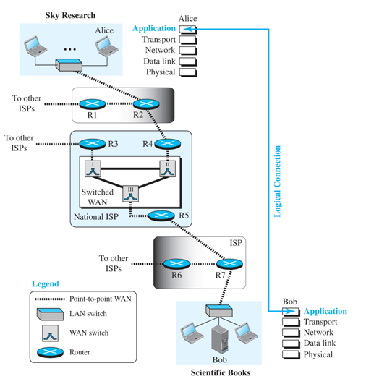
Application layer
The application layer provides services to the user.
Communication is provided using a logical connection, which means that the two application layers assume that there is an imaginary direct connection through which they can send and receive messages.
Figure 10.1 shows the idea behind this logical connection.
Figure 10.1 Logical connection at the application layer

Slide 5
















Creating a network app
application
transport
network
data link
physical
write programs that:
run on (different) end systems
communicate over network
e.g., web server software communicates with browser software
no need to write software for network-core devices
network-core devices do not run user applications
applications on end systems allows for rapid app development, propagation
mobile network
national or global ISP
local or regional ISP
home network
content
provider
network
application
transport
network
data link
physical
application
transport
network
data link
physical
datacenter
network
enterprise
network

Slide 6
Providing Services
The application layer is highest layer in protocol suite and its services only depends upon protocols in transport layer.
Application layer is the only layer that provides services to the Internet user.
The flexibility of the application layer allows new application protocols to be easily added to the Internet.
New protocols can be added and removed from this layer easily as long as new added protocols works with protocols provided by transport layer.
When the Internet was created, only a few application protocols were available to the users; today we cannot give a number for these protocols because new ones are being added constantly.

Slide 7
Application Layer Paradigms
Defines the relationship between two application programs which are running on two different computer to interact with each other.
Three types of paradigms used between two devices for communication in application layer
Client - Server Paradigm
Peer to Peer Paradigm
Mixed Paradigm

Slide 8
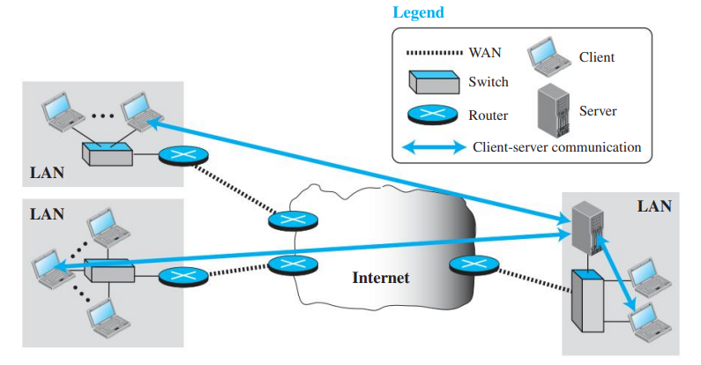
Client - Server Paradigm
It is a traditional paradigm that uses two running application programs, called the server process and the client process, to make a connection through the Internet and ask for service.
A client initializes the communication by sending a request; a server that waits for a request from a client.
The server handles the request received from a client, prepares a result, and sends the result back to the client.
This means that server must be running at all time but client only need to run when it requires services.

Slide 9
client - server paradigm
Advantages -
Centralized system with all data in a single place.
Cost efficient requires less maintenance cost and Data recovery is possible.
The capacity of the Client and Servers can be changed separately.
Disadvantages
If server is infected with virus then client might also get affected.
Server are prone to Denial of Service (DoS) attacks.
Servers have to handle most of the workload which increases as the number of clients increases.

Slide 10
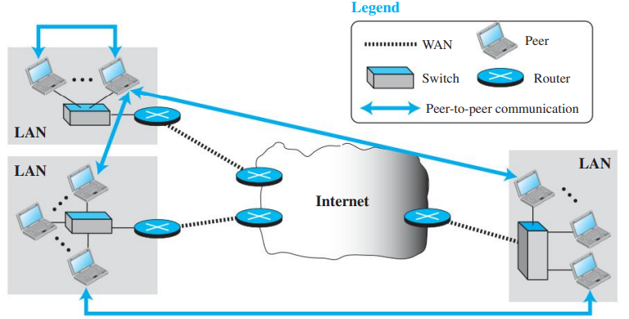
New Paradigm: Peer-to-Peer Paradigm
A new paradigm, which has emerged to respond to the needs of some new applications. E.g BitTorrent, Skype
In this paradigm, there is no need for a server process to be running all the time and waiting for the client processes to connect. The responsibility is shared between peers.
A computer connected to the Internet can provide service at one time and receive service at another time. A computer can even provide and receive services at the same time.

Slide 11
Mixed Paradigm
An application may choose to use a mixture of the two paradigms by combining the advantages of both.
For example, a light-load client-server communication can be used to find the address of the peer that can offer a service.
When the address of the peer is found, the actual service can be received from the peer by using the peer-to-peer paradigm.

Slide 12
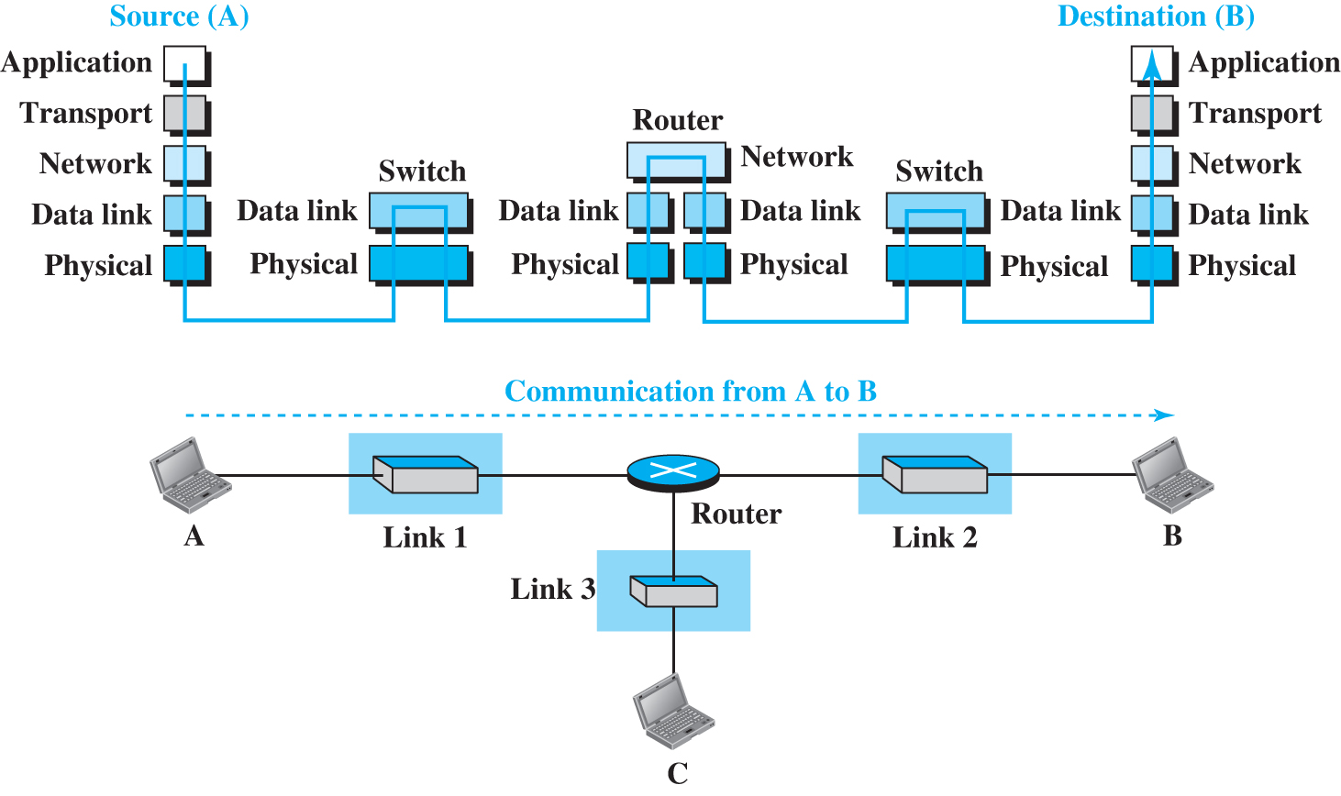
Packet Transmission in TCP/IP Stack

Slide 13
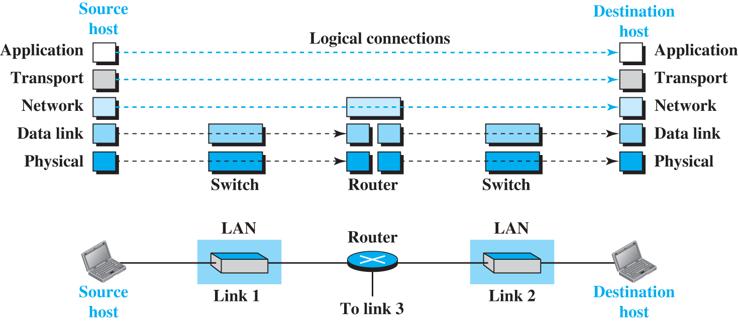
Logical Connections between layers in TCP/IP

Slide 14
CLIENT-SERVER PROGRAMMING
In a client-server paradigm, communication at the application layer is between two running application programs called processes: a client and a server.
A client is initializes the communication by sending a request.
A server waits for a request from a client.
The server handles the request received from a client, prepares a result, and sends the result back to the client.
A client process communicate with a server process using a set of predefined instructions referred to as an application programming interface (API).
The API for the network applications is known as socket API

Slide 15
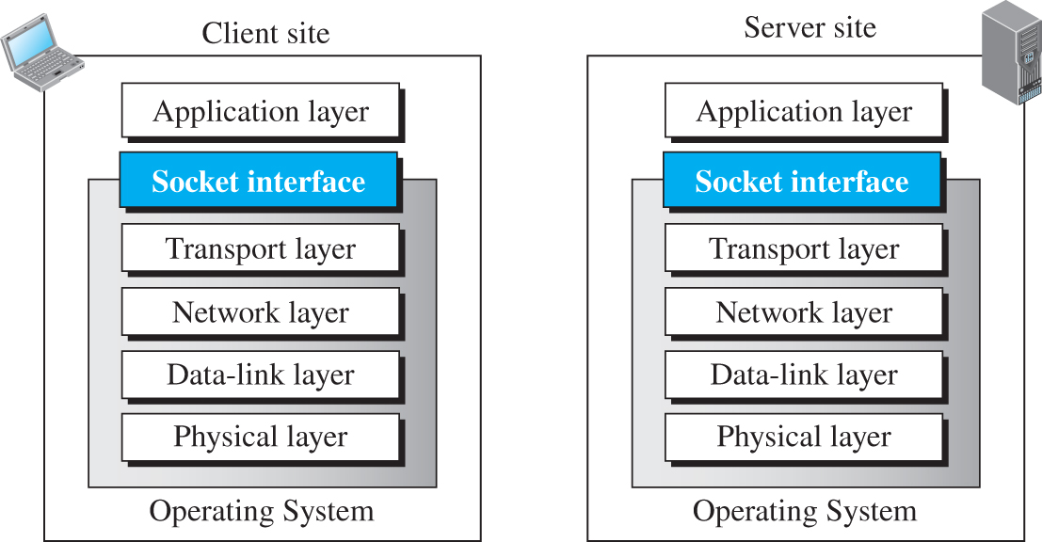
Sockets
A socket is the end point of communication between the client and server.
It acts as the interface between the application layer process and transport layer.
Socket API provides predefined instructions for the network applications.

Slide 16
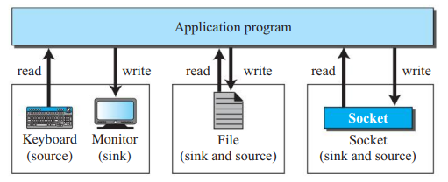
Sockets
Sockets work just like any other input/output devices.
A program can read from sockets and also write to sockets just like interacting with a text file or terminal.
Although a socket is supposed to behave like a terminal or a file, it is not a physical entity like them; it is an abstraction. It is a data structure that is created and used by the application program.

Slide 17
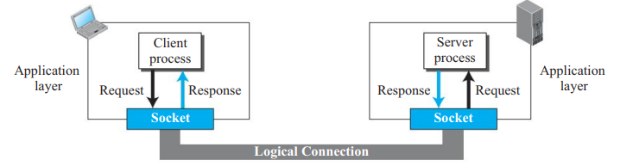
Role of Socket in Process to Process Communication
Two processes think they are communicating to sockets and rest of the functionalities are handled by OS (which implements rest of layers of TCP/IP Protocol suite).

Slide 18
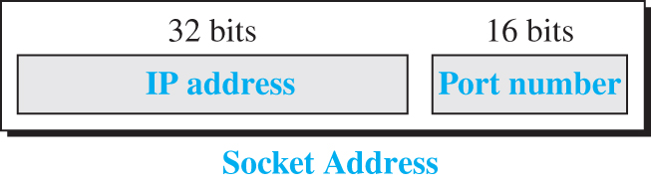
Socket Addresses
Since communication in the client-server paradigm is between two sockets, we need a pair of socket addresses for communication: a local socket address and a remote socket address.
Socket address is defined using IP address and port number
: is used to separate IP address and port number. For eg: 192.168.1.67:80.

Slide 19
10.2.2 Using Services of Transport Layer
A pair of processes, need to use the services provided by the transport layer for communication because there is no physical communication at the application layer.
There are three common transport-layer protocols in the TCP/IP suite: UDP, TCP, and SCTP.
Most standard applications have been designed to use the services of one of these protocols.

Slide 20
UDP Protocol
UDP provides connectionless, unreliable, datagram service.
Connectionless service means that there is no logical connection between the two ends exchanging messages.
Each message is an independent entity encapsulated in a packet called a datagram.
UDP does not see any relation (connection) between consequent datagrams coming from the same source and going to the same destination.

Slide 21
TCP Protocol
TCP provides connection-oriented, reliable, byte-stream service.
TCP requires that two ends first create a logical connection between themselves by exchanging some connection-establishment packets which is called as handshaking.
Handshaking(3-Way Handshaking), establishes some parameters between the two ends including the size of the data packets to be exchanged, the size of buffers to be used for holding the chunks of data until the whole message arrives, and so on.

Slide 22
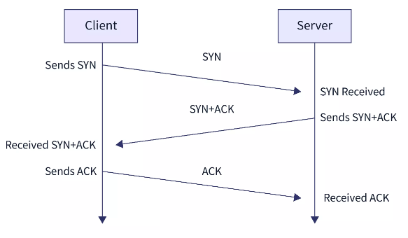
TCP 3-Way Handshaking
It involves three steps:
SYN (Synchronize)
SYN-ACK (Synchronize-Acknowledge)
ACK (Acknowledge).

Slide 23
Application Layer Protocols
In particular, an application-layer protocol defines:
The types of messages exchanged, for example, request messages and response messages.
The syntax of the various message types, such as the fields in the message and how the fields are delineated.
The semantics of the fields, that is, the meaning of the information in the fields.
Rules for determining when and how a process sends messages and responds to messages.

Slide 24
Application layer protocols
Standard Application-Layer Protocols
Some application-layer protocols are specified in RFCs and are therefore in the public domain.
HTTP
SMTP
DNS
Non-standard Application-Layer Protocols
Many application-layer protocols are proprietary and intentionally not available in the public domain.
Skype uses proprietary application-layer protocols.
The IETF (Internet Engineering Task Force), founded in 1986, is the premier standards development organization for the internet. The IETF publishes its technical documentation as RFCs (Requests for Comments). RFCs describe the Internet’s technical foundations, such as addressing, routing, and transport technologies, etc.

Slide 25
The World Wide Web (WWW)
WWW commonly known as the web, is a vast system of interlinked hypertext documents and multimedia content accessible via the internet.
It is one of the primary services available on the internet and has transformed how people access and share information globally.
The Web today is a repository of information in which the documents, called Web pages, are distributed all over the world and related documents are linked together.
Linking allows one web page to refer to another web page stored in another server somewhere else in the world. The linking of web pages was achieved using a concept called hypertext.

Slide 26
Hypertext and Hyperlinks
Hypertext: Text that contains links to other texts. It allows users to navigate between different documents or pages by clicking on hyperlinks.
Hyperlinks: Connections within a hypertext that link one document to another.

Slide 27
Web Documents or Web Pages
Web Page is a single document or file on the web, usually written in HTML (Hypertext Markup Language) and accessible via a web browser.
A web page can contain text, images, videos, and other multimedia content.
It can be accessed by entering the URL on the address bar of the web browser.

Slide 28
Website
A collection of related web pages under a common domain name (e.g., www.example.com).
Websites can range from a few pages to thousands of interconnected pages.

Slide 29
Web Documents types
The documents in the WWW can be grouped into three broad categories –
Static Documents
Dynamic Documents
Active Web Documents

Slide 30
Web Documents types
Static Documents -
Static web documents are fixed content files that are delivered to the user exactly as stored on the web server. They do not change unless manually updated by a developer.
These are typically created using HTML and CSS and does not change based on user interaction.
Dynamic Documents -
Dynamic web documents are generated in real-time by server-side scripts or programs in response to user requests. The content can change based on user interactions, inputs, or other parameters.
These are created using server-side languages like PHP, Python along with HTML, CSS, and JavaScript.

Slide 31
Web Documents types
Active Web Documents -
Active web documents involve client-side scripting and interactivity, often using technologies like JavaScript, AJAX (Asynchronous JavaScript and XML), and WebSockets. They allow for real-time updates and highly interactive user experiences.
These are created using client-side languages and framework like JavaScript, React, etc.

Slide 32
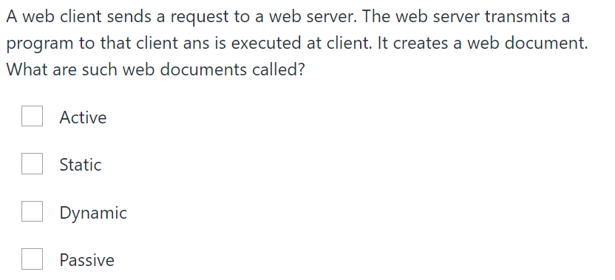
Exercise
Answer - Active Document

Slide 33
Uniform Resource Locator (URL)
The URL, or Uniform Resource Locator, is the web address used to access a resource on the internet.
The URL defines four things: protocol, host computer, port and path.
The protocol is the client/server program used to retrieve the document.
The host is the computer on which the information is located. Web pages are usually stored in computers, and computers are given alias names that usually begin with the characters "www".
The URL can optionally contain the port number of the server. If the port is included, it is inserted between the host and the path, and it is separated from the host by a colon.
Path is the pathname of the file where the information is located.
https://github.com/practical-tutorials/project-based-learning?tab=readme-ov-file#cc

Slide 34
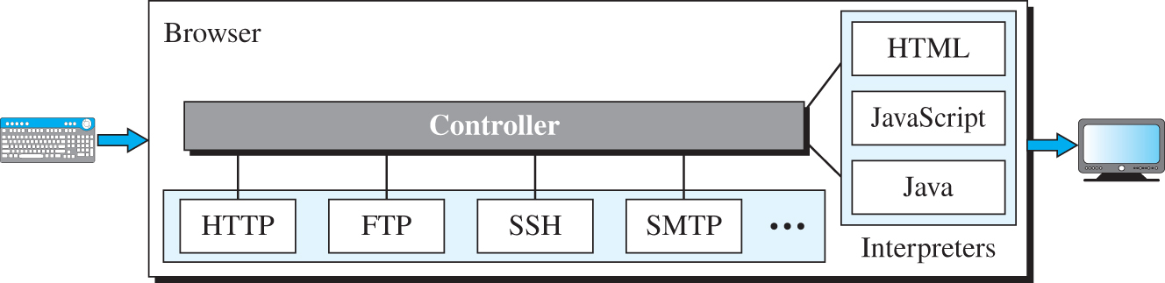
Web Client (Browser)
A variety of vendors offer commercial browsers that interpret and display a web page, and all of them use nearly the same architecture.
Each browser usually consists of three parts -
Controller - receives input from the keyboard or mouse.
Client Protocols - Controller uses client protocols like HTTP to fetch the data from server.
Interpreters - After the document has been accessed, the controller uses one of the interpreters to interpret and display the document on the screen.

Slide 35
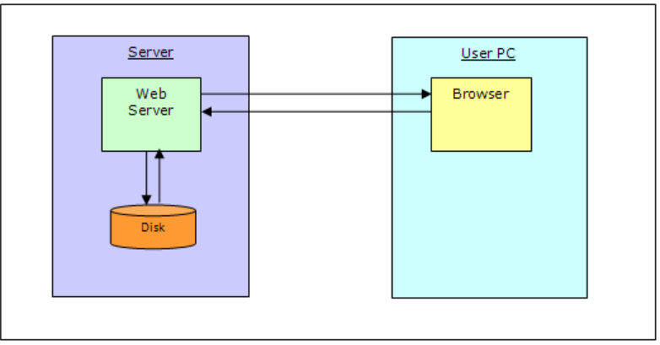
Interaction between web browser and web server
Apache Web Server
IIS
Apache Tomcat
Google Chrome
Mozilla Firefox
Internet Explorer

Slide 36
Web Server
A web server is a type of software or hardware that serves web pages to users over the internet. Its main job is to handle incoming requests from web browsers or other clients and deliver the requested web content.
Working of Web Server
Receiving Requests: When you type a URL into your browser or click on a link, your browser sends a request to a web server to access a specific web page.
Processing Requests: The web server receives this request and determines what content is needed. It could be a static file (like an HTML page or an image) or it might need to run some server-side code (like PHP, Python, or JavaScript) to generate the content dynamically.
Sending Responses: Once the web server has the content ready, it sends it back to your browser as an HTTP response. Your browser then renders this content so you can view the web page.

Slide 37
How the browser interacts with the servers?
There are few steps to follow to when client wants to interact with a server -
User enters the URL(Uniform Resource Locator) of the website or file. The Browser then requests the DNS(DOMAIN NAME SYSTEM) Server.
DNS Server lookup for the address of the WEB Server.
DNS Server responds with the IP address of the WEB Server.
Browser sends over an HTTP/HTTPS request to WEB Server’s IP (provided by DNS server).
Server sends over the necessary files of the website.
Browser then renders the files and the website is displayed. This rendering is done with the help of DOM (Document Object Model) interpreter, CSS interpreter and JS Engine collectively known as the JIT or (Just in Time) Compilers.

Slide 38
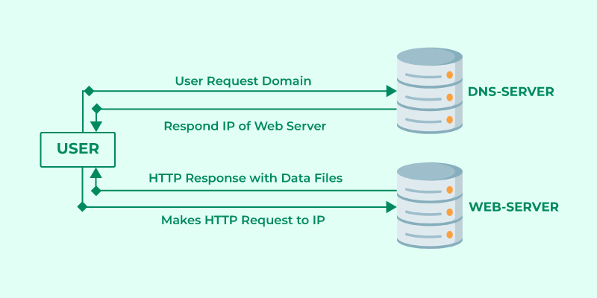
Interaction between web browser and web server

Slide 39
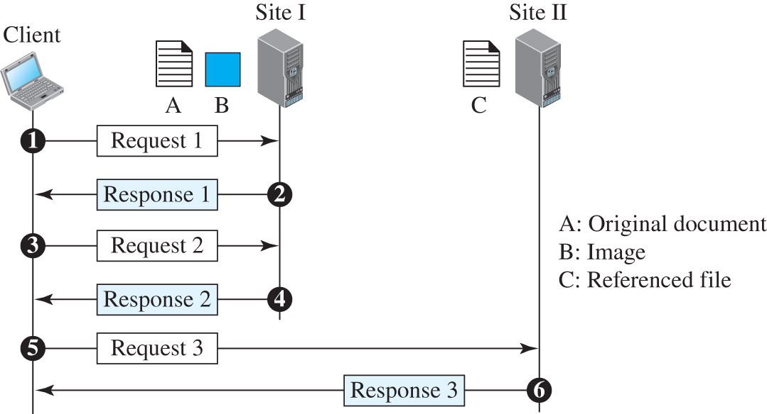
Example 10.2
Assume we need to retrieve a scientific document that contains one reference to another text file and one reference to a large image. Figure 10.8 shows the situation.
Figure 10.8

Slide 40
HypterText Transfer Protocol (HTTP)
It is a protocol used for transferring hypertext requests and information on the World Wide Web. Here's how it works in the application layer:
The HTTP uses the services of TCP, which is a connection-oriented and reliable protocol. This means that before any transaction between the client and the server can take place, a connection needs to be established between them. After the transaction is completed, connection is terminated.
An HTTP client sends a request; an HTTP server returns a response.
The server uses the port number 80; the client uses a temporary port number.
The client and server do not need to worry about errors in messages exchanged or loss of any message because the TCP protocol will handle all these issues.

Slide 41
Working of http in the application layer
1. Client-Server Model: http uses client server model
Client: The client sends a request to a server using a web browser or any HTTP client (like curl or Postman).
This request could be for web pages, images, or other resources.
Server: The server processes the client's request and sends back the appropriate response, typically in the form of HTML, JSON, XML, images, or other media.

Slide 42
Working of http in the application layer
2. Request/Response Structure:
HTTP Request: The HTTP request includes:
Request Line: Specifies the method (e.g., GET, POST), the resource URL, and the HTTP version.
Headers: Provide additional information about the request (e.g., User-Agent, Content-Type(Accept: image/jpeg)).
Body: (Optional) Contains data to be sent to the server, mainly in POST or PUT requests.
HTTP Response: The server responds with:
-Status Line: Indicates the HTTP version and the status code (e.g., 200 OK, 404 Not Found).
-Headers: Provide information about the response (e.g., Content-Type, Content-Length).
-Body: Contains the requested resource or error message.

Slide 43
Working of http in the application layer
3. Methods used by http:
GET: Requests data from a specified resource.
POST: Sends data to the server to create or update a resource
PUT: Updates a current resource with new data.
DELETE: Deletes a specified resource.
HEAD, OPTIONS, PATCH: Other methods used for specific purposes.

Slide 44
HTTP a Stateless Protocol:
HTTP is stateless, meaning each request from the client to the server is independent.
The server does not store any state about the client between requests.
However, sessions and cookies can be used to maintain stateful interactions.

Slide 45
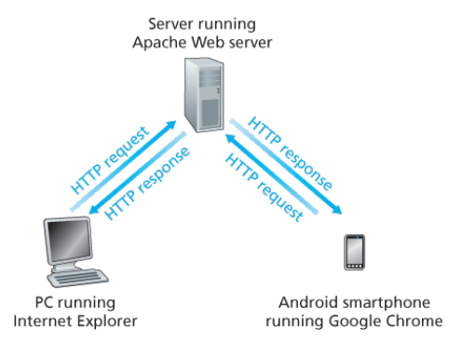
HTTP Server-Client Communication

Slide 46
Connection Types: Non persistent vs Persistent Connections
As we have discussed, HTTP establishes a connection between server and client before they can communicate with each other.
So if a client wants to retrieve a webpage, it need to establish a connection with server first.
WHAT IF client want to retrieve multiple webpages?
WHAT IF all webpages are on different servers?
WHAT IF all the webpages are on the same server?
Would it need a new connection for each webpage? or It can be done using a single connection only?

Slide 47
Nonpersistent Connections
In a non persistent connection, separate TCP connection is made for each request made by client.
Steps:
The client opens a TCP connection and sends a request.
The server sends the response and closes the connection.
The client reads the data until it encounters an end-of-file marker; it then closes the connection.
In this strategy, if a file contains links to N different pictures in different files (all located on the same server), the connection must be opened and closed N + 1 times.
The non persistent strategy imposes high overhead on the server because the server needs N+1 different buffers each time a connection is opened.

Slide 48
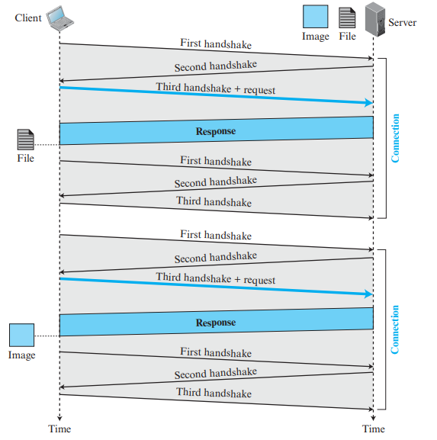
Example: Nonpersistent Connection
Figure 10.10 shows an example of a nonpersistent connection. The client needs to access a file that contains one link to an image. The text file and image are located on the same server.
Here we need two connections. For each connection, TCP requires at least three handshake messages to establish the connection, but the request can be sent with the third one.
After the connection is established, the object can be transferred.
After receiving an object, another three handshake messages are needed to terminate the connection.
Figure 10.10

Slide 49
Persistent Connections
In a persistent connection, the server leaves the connection open for more requests after sending a response.
The server can close the connection at the request of a client or if a time-out has been reached.
From HTTP 1.1 persistent connections are default option. Although It can be changed based on user requirements.
Time and resources are saved using persistent connections. Only one set of buffers and variables needs to be set for the connection at each site. The round trip time for connection establishment and connection termination is saved.
The sender usually sends the length of the data with each response. However, there are some occasions when the sender does not know the length of the data. This is the case when a document is created dynamically or actively.
In these cases, the server informs the client that the length is not known and closes the connection after sending the data so the client knows that the end of the data has been reached.

Slide 50
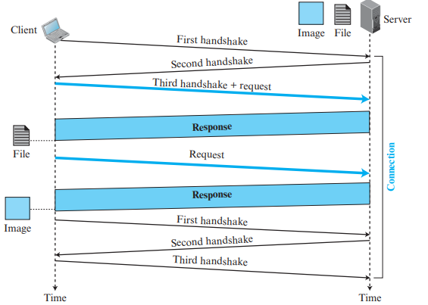
Example: Persistent Connection
Figure 10.11 shows an example of a persistent connection.
The client needs to access a file that contains one link to an image.
The text file and image are located on the same server.
Only one connection establishment and connection termination is used, but the request for the image is sent separately.
Figure 10.11

Slide 51
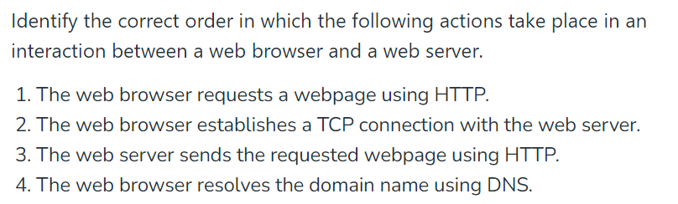
Exercise
Correct sequence is: 4 -> 2 -> 1 -> 3

Slide 52
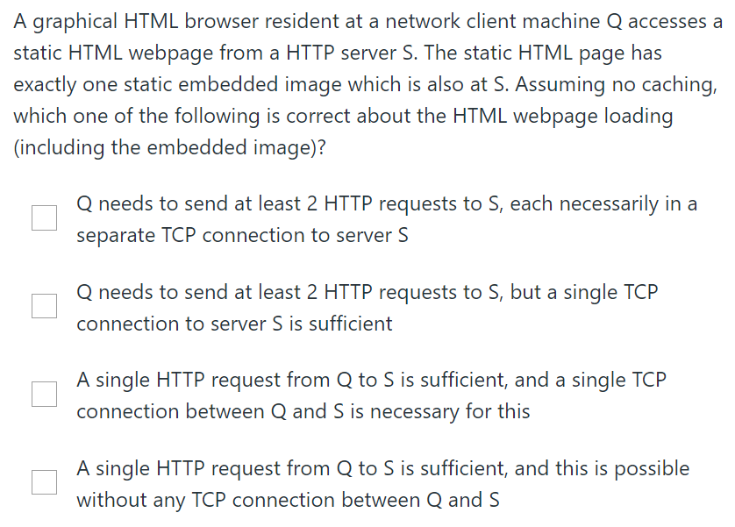
Exercise
Answer - Q needs to send at least 2 HTTP requests to S, but a single TCP connection to server S is sufficient.

Slide 53
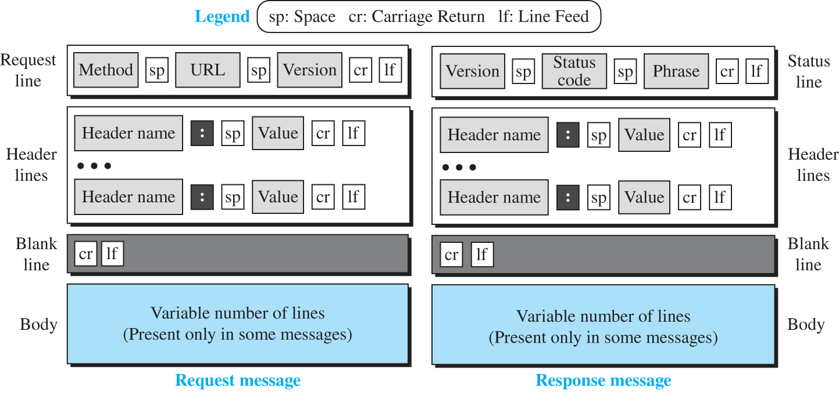
Figure 10.12 Formats of the request and response messages
Access the text alternative for slide images.

Slide 54
Table 10.1 Methods
Method | Action
GET | Requests a document from the server
HEAD | Requests information about a document but not the document itself
PUT | Sends a document from the client to the server
POST | Sends some information from the client to the server
TRACE | Echoes the incoming request
DELETE | Removes the web page
CONNECT | Reserved
OPTIONS | Inquires about available options

Slide 55
Table 10.2 Request header names
Header | Description
User-agent | Identifies the client program
Accept | Shows the media format the client can accept
Accept-charset | Shows the character set the client can handle
Accept-encoding | Shows the encoding scheme the client can handle
Accept-language | Shows the language the client can accept
Authorization | Shows what permissions the client has
Host | Shows the host and port number of the client
Date | Shows the current date
Upgrade | Specifies the preferred communication protocol
Cookie | Returns the cookie to the server (explained later in this section)
If-Modified-Since | Specifies if the file has been modified since a specific date

Slide 56
Table 10.3 Response header names
Header | Description
Date | Shows the current date
Upgrade | Specifies the preferred communication protocol
Server | Gives information about the server
Set-Cookie | The server asks the client to save a cookie
Content-Encoding | Specifies the encoding scheme
Content-Language | Specifies the language
Content-Length | Shows the length of the document
Content-Type | Specifies the media type
Location | To ask the client to send the request to another site
Accept-Ranges | The server will accept the requested byte-ranges
Last-modified | Gives the date and time of the last change

Slide 57
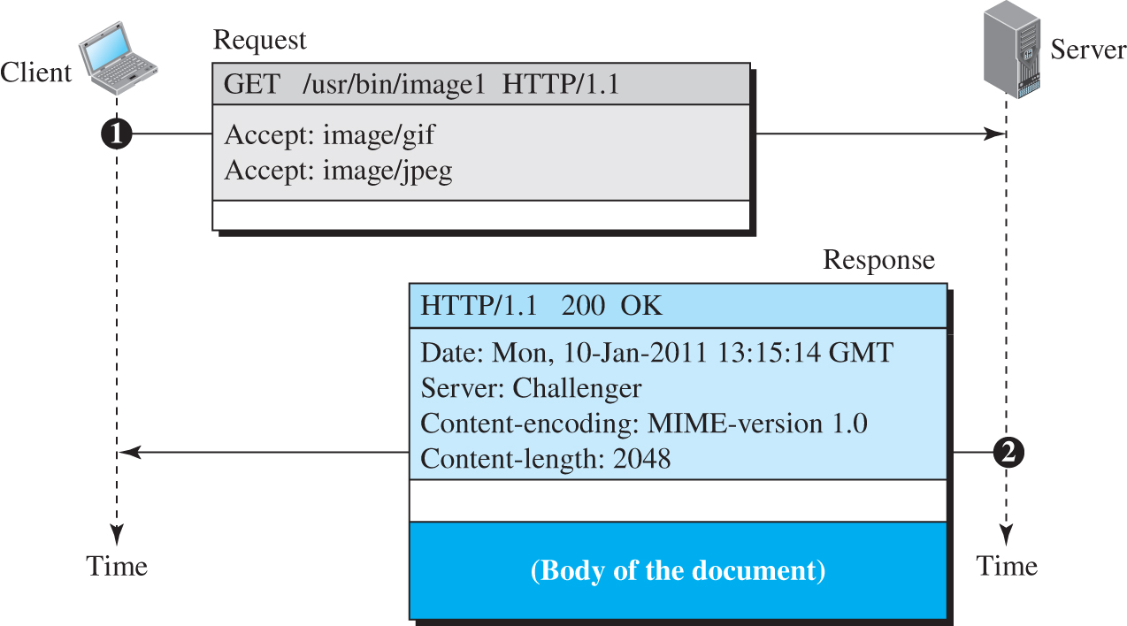
Example 10.6
In this example client wants to retrieve a document (see Figure 10.13). We use the GET method to retrieve an image with the path /usr/bin/image1.
The request line shows the method (GET), the URL, and the HTTP version (1.1).
The header has two lines that show that the client can accept images in the GIF or JPEG format.
The request does not have a body. The response message contains the status line and four lines of header.
The header lines define the date, server, content encoding (MIME version, which will be described in electronic mail), and length of the document. The body of the document follows the header.
Figure 10.13.
Access the text alternative for slide images.

Slide 58
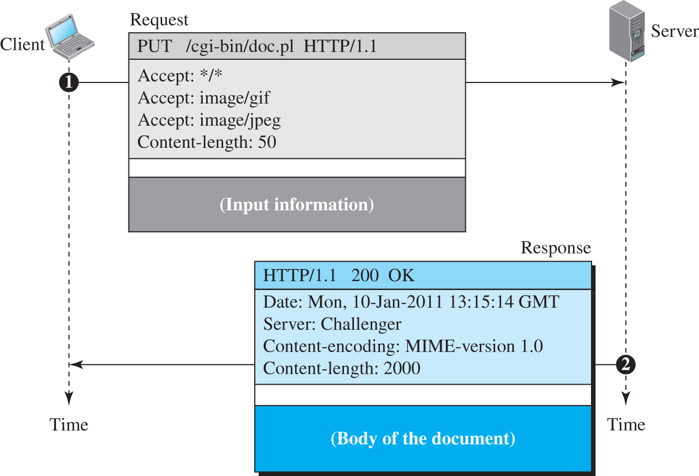
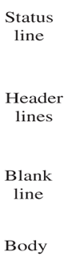
Example 10.7
In this example, the client wants to send a web page to be posted on the server using the PUT method.
The request line shows the method (PUT), URL, and HTTP version (1.1).
There are four lines of headers.
The request body contains the web page to be posted.
The response message contains the status line and four lines of headers.
The created document, which is a CGI document, is included as the body (see Figure 10.14).
Request line
Header line
Blank line
Body
Figure 10.14).
Access the text alternative for slide images.

Slide 59
Conditional Request
A client can add a condition in its request. In this case, the server will send the requested web page if the condition is met or inform the client otherwise.
One of the most common conditions imposed by the client is the time and date the web page is modified.
The client can send the header line If-Modified-Since with the request to tell the server that it needs the page only if it is modified after a certain point in time.

Slide 60
Example 10.8
The following shows how a client imposes the modification data and time condition on a request.
GET http://www.commonServer.com/information/file1 HTTP/1.1 | Request line
If-Modified-Since: Thu, Sept 04 00:00:00 GMT | Header line
 | Blank line
The status line in the response shows the file was not modified after the defined point in time. The body of the response message is also empty.
HTTP/1.1 304 Not Modified | Status line
Date: Sat, Sept 06 08 16:22:46 GMT | First header line
Server: commonServer.com | Second header line
 | Blank line
(Empty Body) | Empty body

Slide 61

Cookies
Internet Cookies (aka web cookies) are small text files which store user-specific information and user preferences.
Cookies can help to track your activity and behavior online in order to personalize your experience.
However, they can also be used to violate your online privacy.

Slide 62
Creating and Storing Cookies
When a server receives a request from a client, it stores information about the client and preferences in a file known as cookie.
The server includes the cookie in the response that it sends to the client.
When the client receives the response, the browser stores the cookie in the cookie directory as the server domain name.
Cookies are sent back to the server on each request to the same domain.

Slide 63
Using Cookies
When a client sends a request to a server, the browser looks in the cookie directory to see if it can find a cookie sent by that server. If found, the cookie is included in the request.
When the server receives the request, it knows that this is an old client, not a new one.
Note that the contents of the cookie are never read by the browser or disclosed to the user. It is a cookie made by the server and eaten by the server.
Example: E-commerce Cookie
An electronic store (e-commerce) can use a cookie for its client shoppers.
When a client selects an item and inserts it in a cart, a cookie that contains information about the item, such as its number and unit price, is sent to the browser.
If the client selects a second item, the cookie is updated with the new selection information, and so on.
When the client finishes shopping and wants to check out, the last cookie is retrieved and the total charge is calculated.

Slide 64
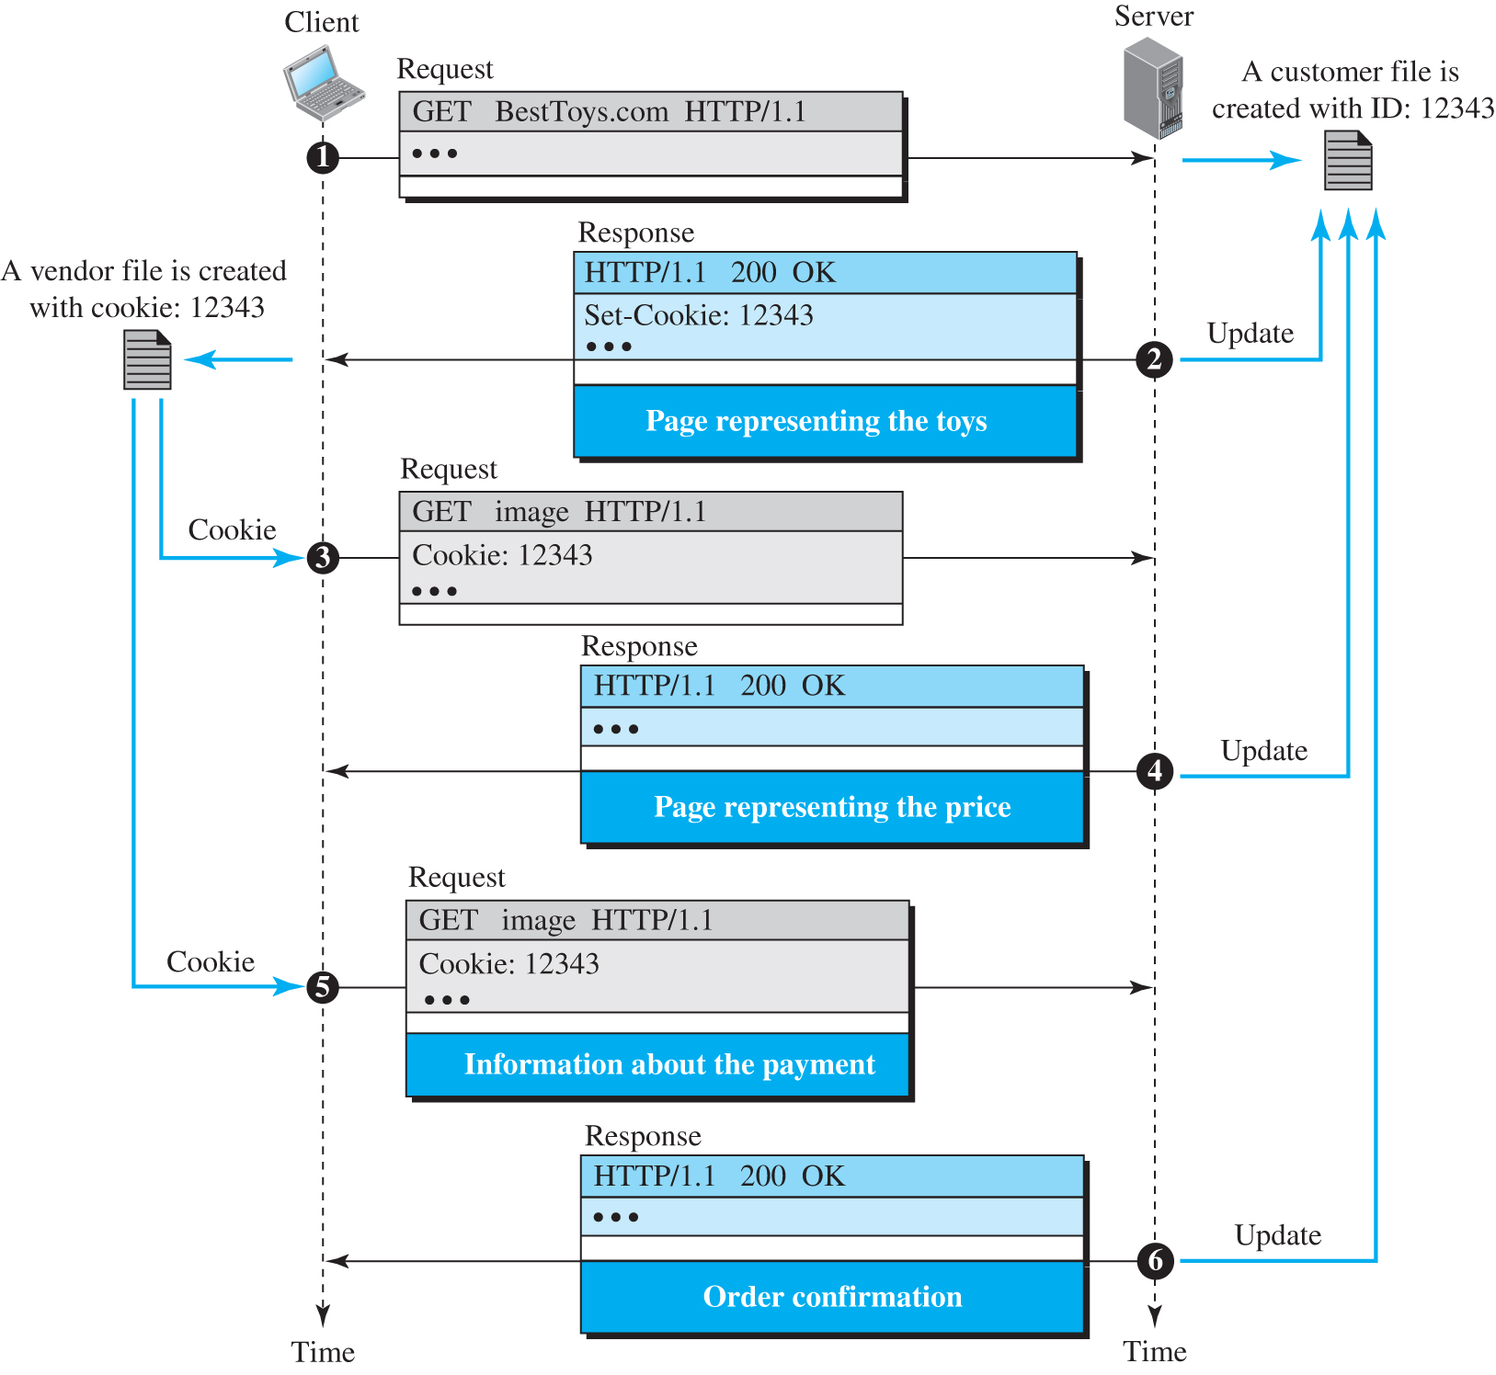
Example: Cookie
Figure 10.15 shows a scenario in which an electronic store can benefit from the use of cookies.
Assume a shopper wants to buy a toy from an electronic store named BestToys.
The shopper browser (client) sends a request to the BestToys server.
The server creates an empty shopping cart (a list) for the client and assigns an ID to the cart (for example, 12343).
The server then sends a response message, which contains the images of all toys available, with a link under each toy that selects the toy if it is being clicked.
This response message also includes the Set-Cookie header line whose value is 12343.
The client displays the images and stores the cookie value in a file named BestToys.
Figure 10.15

Slide 65
Web Caching: Proxy Server
A proxy server is a computer that keeps copies of responses to recent requests.
When the HTTP client sends a request, it is first goes to the proxy server.
The proxy server checks the response in its cache and sends the response to the client if found.
If the response is not stored in the cache, the proxy server sends the request to the corresponding server.
Incoming responses are sent to the proxy server and stored for future requests from other clients.
The proxy server reduces the load on the original server, decreases traffic, and improves latency.
However, to use the proxy server, the client must be configured to access the proxy instead of the target server.
Proxy server acts as both server and client.

Slide 66
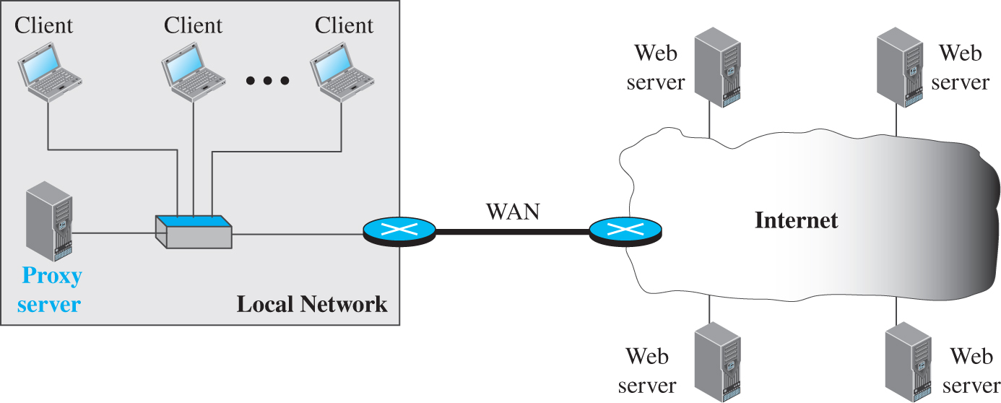
Proxy Server Location
The proxy servers are normally located at the client site.
A client computer can also be used as a proxy server, in a small capacity that stores responses to requests often invoked by the client.
In a company, a proxy server may be installed on the computer LAN to reduce the load going out of and coming into the LAN.
An ISP with many customers can install a proxy server to reduce the load going out of and coming into the ISP network.

Slide 67
Example of a proxy server
Figure 10.16
Figure 10.16 shows an example of a use of a proxy server in a local area network, such as the network on a campus or in a company.
When an HTTP request is created by any of the clients (browsers), the request is first directed to the proxy server. If the proxy server already has the corresponding web page, it sends the response to the client.
Otherwise, the proxy server acts as a client and sends the request to the web server in the Internet.
When the response is returned, the proxy server makes a copy and stores it in its cache before sending it to the requesting client.

Slide 68
Proxy Server: Cache Update Strategies
Time-Based Expiry (TTL): After TTL expires, the proxy server will fetch a fresh copy from the origin server.
Cache Invalidation: You can manually clear or invalidate specific cache entries.
Cache Purging: Cache is automatically updated regularly based on some policies without manual intervention.
Cache Control Headers: header from the original server tells the proxy server how long to cache the response.

Slide 69
HTTP Security
HTTP does not have inbuilt mechanism for providing security.
But HTTP can be run over the Secure Socket Layer (SSL) which is referred as HTTPS.
HTTPS provides confidentiality, client and server authentication, and data integrity.

Slide 70
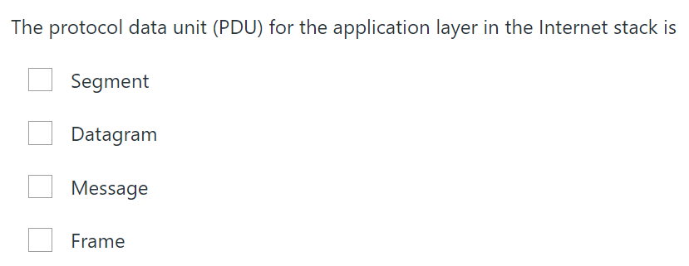
Exercise
Answer - Message

Slide 71
Domain Name system (DNS)

Slide 72
Domain Name System (DNS)
It is a directory system that maps a name to an IP address and vice versa.
DNS client(software on a device) and a DNS servers(e.g ISP server) are used to map a name to an IP address.
DNS is a supporting program that is used by other programs such as e-mail.
The DNS client program sends a request to a DNS server to map the e-mail address to the corresponding IP address.
DNS server sends a response to the client with the requested IP

Slide 73
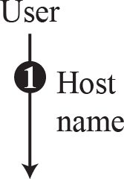
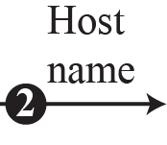
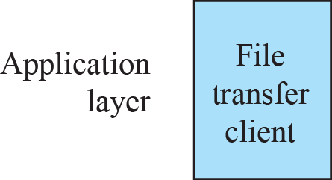
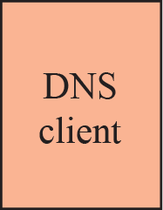


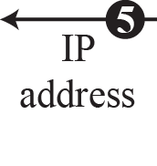

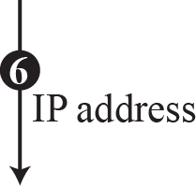

Mapping a name to an IP address by DNS client and DNS server
The Internet needs to have a directory system that can map a name to an address and vice versa.
This is analogous to the telephone network.
Figure 10.35: How TCP/IP uses a DNS client and a DNS server to map a name to an address

Slide 74
NAME SPACE
Namespace is a hierarchical and distributed naming system that maps name to IP
The names must be unique because the addresses are unique.
It can be organized in two ways:
Flat name space
Hierarchical name space.
Flat name space: all names are on the same level and must be globally unique.
Hierarchical name space: Organized in a tree-like structure or multi-level hierarchy. Suitable for complex systems and large-scale environments.

Slide 75
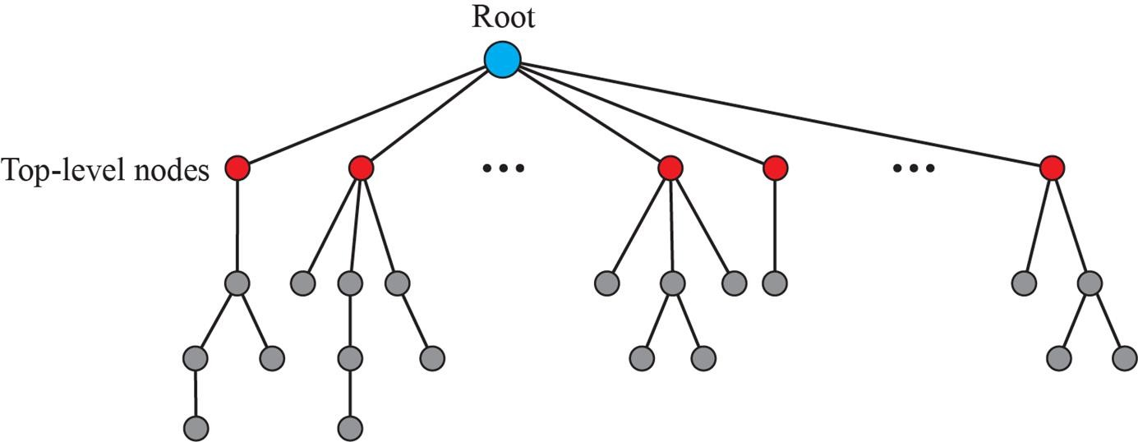
HIERARCHICAL DOMAIN NAME SPACE
Inverted-tree structure with the root at the top.
Each node in the tree has a label,
The root label is a null string (empty string).
Names are organized into parent-child relationships.
The labels are organized from right to left.
.com
Delegation and Authority:
Delegation:
Authority to manage a domain is delegated from the root level to TLDs and from TLDs to second-level domains.
Authority:
Each level has authoritative servers or managers responsible for that part of the namespace.
example
mail
mail.example.com
Levels and Sublevels:
Top-Level Domains (TLDs): Domain just below the root. Example .com and .org are at the top of the hierarchy.
Second-Level Domains: Below TLDs are second-level domains (e.g., example.com).
Sub domains: Further subdivisions, such as mail.example.com.

Slide 76
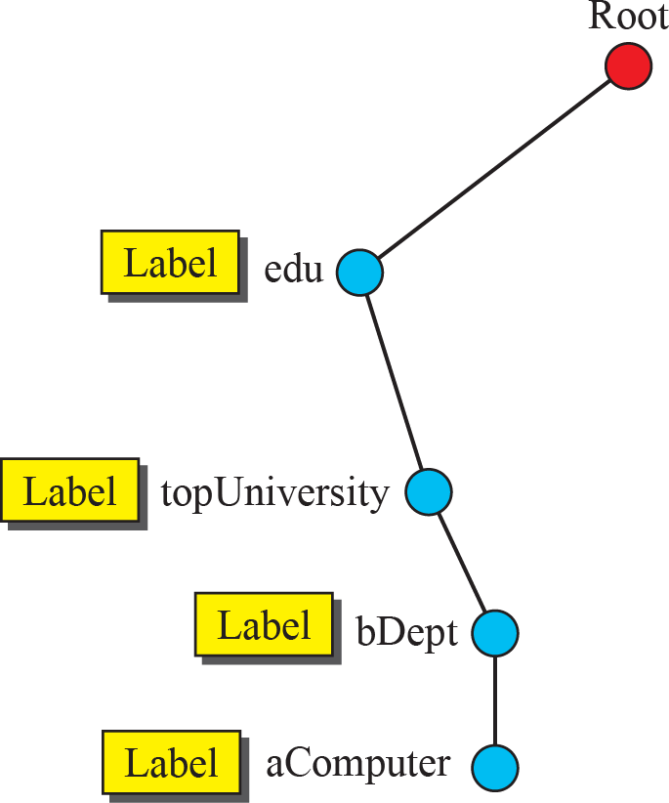
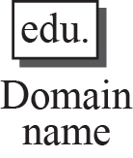



Domain Name
The labels are organized from right to left.
Each node in the tree has a domain name.
A full domain name is a sequence of labels separated by dots (.).
The domain names are always read from the node up to the root.
The last label is the label of the root (null).
This means that a full domain name always ends in a null label

Slide 77
Fully Qualified Domain Name (FQDN)
Complete domain name that specifies exact location in the DNS hierarchy.
FQDN provides unique address for a resource on the internet.
Components of Fully Qualified Domain Name (FQDN)
Hostname
Domain Name
Top-Level Domain (TLD)
Example: "mail.example.com",
Hostname: This is the specific name of the machine or service within a domain.
"mail" is hostname
Domain Name: This is the name of the domain in which the hostname resides.
"example.com" is the domain name.
Top-Level Domain (TLD): This is the highest level of the domain name system.
“.com" is the TLD.

Slide 78
Partially Qualified Domain Name (PQDN)
Specifies only a portion of the full domain hierarchy
PQDN Example: mail.example
This specifies a hostname (mail) within a domain (example), but does not include the top-level domain (TLD) like .com, .org, etc.
PQDNs used in internal networks or private DNS setups where the domain hierarchy is predefined or understood within a specific context.

Slide 79
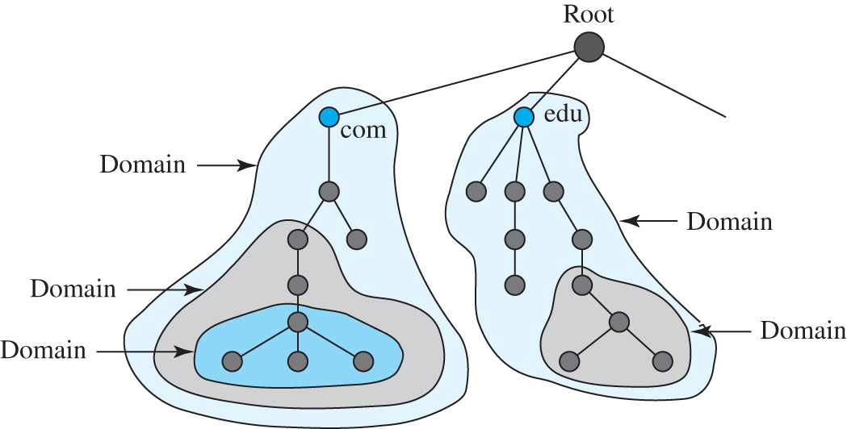
Domains
Domain refers to a hierarchical naming system used to identify and locate resources on the Internet
Figure 10.38
Access the text alternative for slide images.

Slide 80
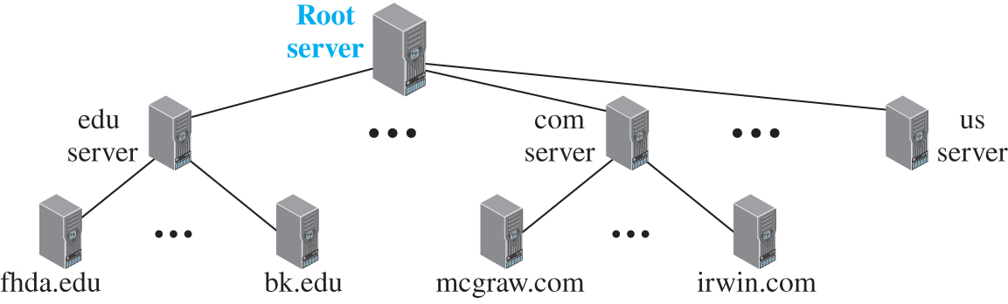
Hierarchy of name servers
Name servers are are responsible for translating domain names into IP addresses
Figure 10.39
Access the text alternative for slide images.

Slide 81
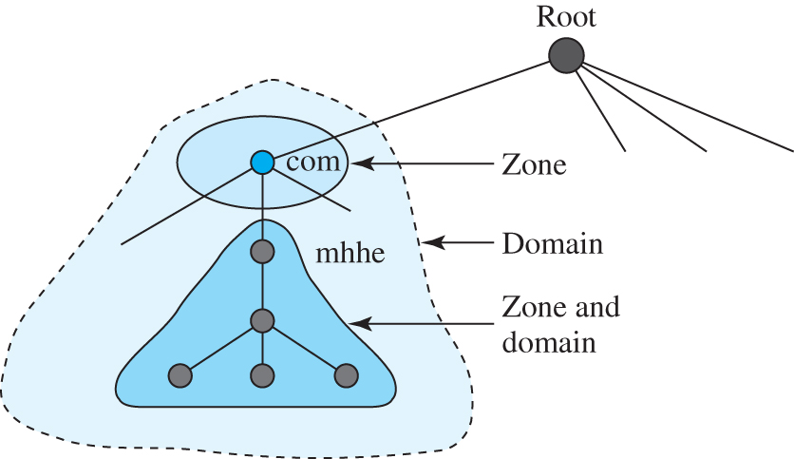
Zone
Figure 10.40
zone refers to a distinct, administrative portion of the DNS namespace that is managed by a specific DNS server or group of servers.
A zone contains the DNS records for a domain and possibly its subdomains, defining how DNS queries for that domain are resolved.

Slide 82
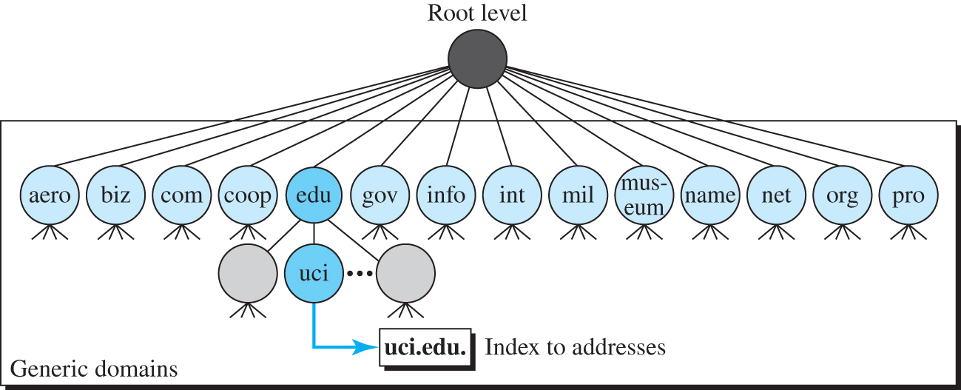
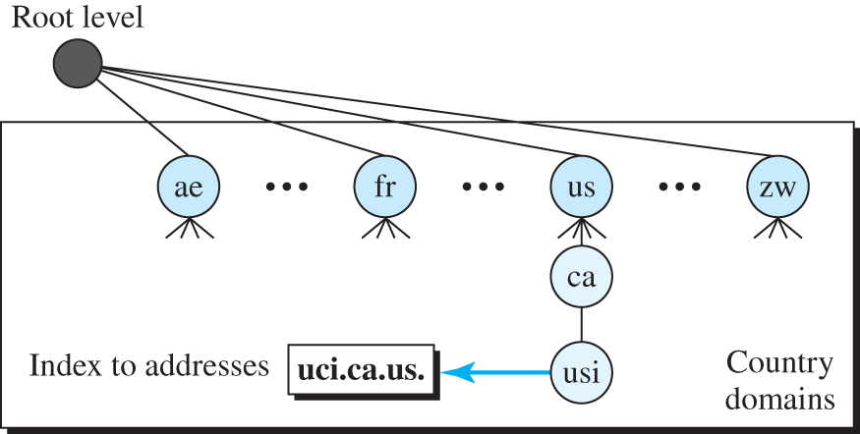
Types of Types of Top Level Domains
Divided into three different sections: generic domains, country domains, and the inverse domains.
Figure 10.42 Country domains
Figure 10.41 Generic domains

Slide 83
Table 10.12 Generic domain labels
Label | Description | Label | Description
aero | Airlines and aerospace | int | International organizations
biz | Businesses or firms | mil | Military groups
com | Commercial organizations | museum | Museum
coop | Cooperative organizations | name | Personal names (individuals)
edu | Educational institutions | net | Network support centers
gov | Government institutions | org | Nonprofit organizations
info | Information service providers | pro | Professional organizations

Slide 84
Resolution
Mapping a name to an address is called name-address resolution.
A host that needs to map an address to a name or a name to an address calls a DNS client called a resolver.
When a client (such as a web browser) needs to resolve a domain name (e.g., www.example.com), it sends a DNS query to a resolver(local server also known as DNS client).
The resolver accesses the closest DNS server with a mapping request.
If the server has the information, it satisfies the resolver; otherwise, it either refers the resolver to other servers or asks other servers to provide the information.
Types of Resolution:
Recursive resolution
Iterative resolution

Slide 85
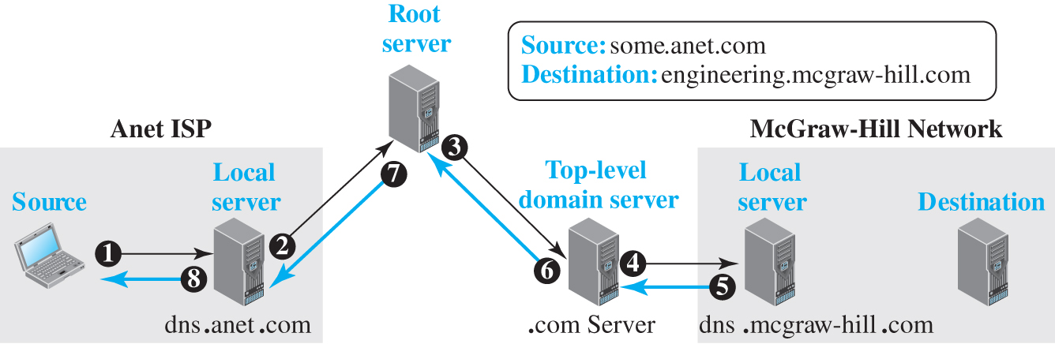
Figure 10.43 Recursive resolution
When a client (such as a web browser) needs to resolve a domain name (e.g., www.example.com), it sends a DNS query to a recursive resolver(local server).
The resolver performs the entire query process and provides a final answer to the client.
Access the text alternative for slide images.

Slide 86
Steps in Recursive Resolution
Initial Query: The recursive resolver receives the DNS query from the client and starts the resolution process.
Query Root Name Servers: The resolver queries one of the root name servers. Root servers do not have information about specific domain names but can direct the resolver to the appropriate Top-Level Domain (TLD) name servers.
Query TLD Name Servers: The root name server responds with the address of the TLD name servers (e.g., for .com). The recursive resolver then queries one of these TLD name servers to get information about the authoritative name servers for the domain.
Query Authoritative Name Servers: The TLD name server responds with the addresses of the authoritative name servers for the domain (e.g., ns1.example.com). The recursive resolver then queries one of these authoritative servers.
Retrieve DNS Records:The authoritative name server for the domain responds with the requested DNS records (e.g., the A record for www.example.com, which contains the IP address).
Return Response to Client: The recursive resolver returns the final DNS records to the client. It also caches the response for future queries, which helps to speed up subsequent lookups and reduce load on authoritative servers.

Slide 87
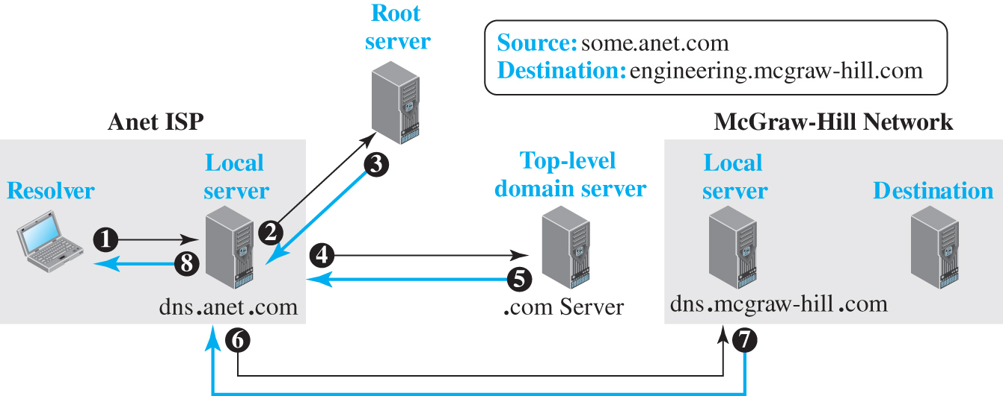
Figure 10.44 Iterative resolution
DNS resolver (or client) performs a series of steps to resolve a domain name, relying on a chain of referrals rather than performing the entire resolution process itself.
This approach contrasts with recursive resolution, where the resolver handles the entire resolution process on behalf of the client.
Access the text alternative for slide images.

Slide 88
Iterative resolution
Client: sends a DNS query to a DNS resolver(Local server) to resolve a domain name
Local DNS Server (or resolver):If it doesn’t have the result cached, it queries a root name server.
Root Name Server: Responds with a referral to the TLD name servers.
Local DNS Server: Queries one of the TLD name servers.
TLD Name Server: Responds with a referral to the authoritative name servers.
Local DNS Server: Queries the authoritative name servers.
Authoritative Name Server: Responds with the final DNS record.
Local DNS Server: Returns the IP address to the client and caches the result.

Slide 89
step-by-step breakdown of the iterative resolution process with example
Client initiates a DNS query for www.example.com.
Local DNS Server (or resolver):If it doesn’t have the result cached, it queries a root name server.
Root Name Server: Responds with a referral to the .com TLD name servers.
Local DNS Server: Queries one of the .com TLD name servers.
TLD Name Server: Responds with a referral to the authoritative name servers for example.com.
Local DNS Server: Queries the authoritative name servers for example.com.
Authoritative Name Server: Responds with the final DNS record for www.example.com (e.g., its IP address).
Local DNS Server: Returns the IP address to the client and caches the result.

Slide 90
Resource Records
A resource record is a 5-tuple structure stored in DNS databases.
Each record provides specific information about a domain.
The zone information associated with a server is implemented as a set of resource records.
5-tuple structure, as shown below:
(Domain Name, Type, Class, TTL, Value)
Name (Domain Name): Specifies the domain or subdomain to which the record applies.
TTL (Time to Live): Indicates how long the record should be cached by DNS resolvers.
Class: Usually "IN" (Internet), indicating the record is for the Internet.
Type: Specifies the type of DNS record (e.g., A, MX, CNAME).
Data: Contains the actual data or value for the record (e.g., IP address, mail server).

Slide 91
Table 10.13 DNS types
Type | Interpretation of value
A | A 32-bit IPv4 address
NS | Identifies the authoritative servers for a zone. Authoritative servers are responsible for providing answers to DNS queries for the domain.
CNAME | Defines an alias for the official name of a host
SOA | Provides information about the domain’s DNS zone Marks the beginning of a zone
MX | Specifies the mail server for the domain name. Redirects mail to a mail server
AAAA | An IPv6 address (see Chapter 7)

Slide 92
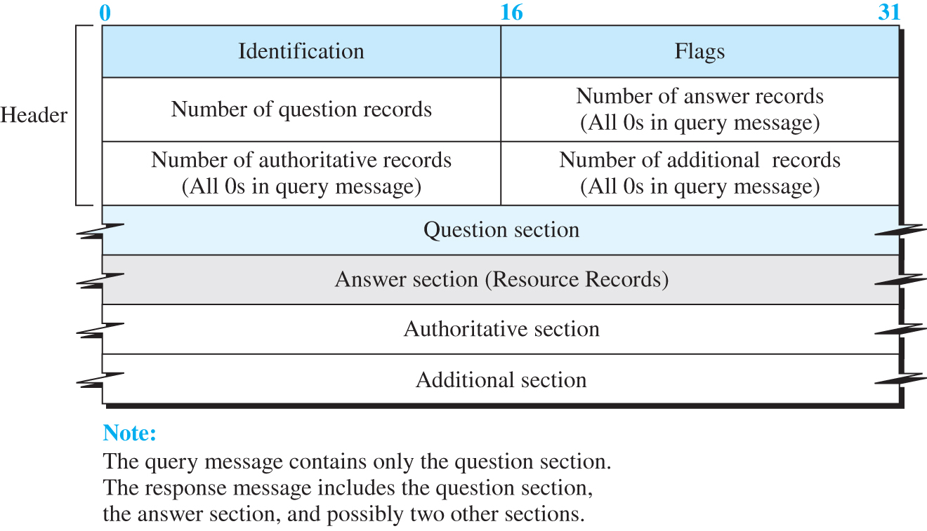
DNS Messages
To retrieve information about hosts, DNS uses two types of messages
query message
Response message.
Both types have the same format as shown in Figure 10.45.

Slide 93
Example 10.14
In UNIX and Windows, the nslookup utility can be used to retrieve address/name mapping. The following shows how we can retrieve an address when the domain name is given.
$nslookup www.forouzan.biz
Name: www.forouzan.biz
Address: 198.170.240.179

Slide 94
Encapsulation
DNS can use either UDP or TCP.
In both cases the well-known port used by the server is port 53.
UDP is used when the size of the response message is less than 512 bytes because most UDP packages have a 512-byte packet size limit.
If the size of the response message is more than 512 bytes, a TCP connection is used. In that case, one of two scenarios can occur.

Slide 95
Registrars
A DNS registrar is a company or organization authorized to manage the registration of domain names.
Example: addition of new domains, Renewals and Expirations .
Registrar is accredited by ICANN.
A registrar first verifies that the requested domain name is unique and then enters it into the DNS database.

Slide 96
Electronic mail

Slide 97
Electronic mail
Electronic mail (or e-mail) allows users to exchange messages.
The nature of Email is different from other applications such as HTTP or FTP
In HTTP or FTP, the server program is running all the time, waiting for a request from a client.
When the request arrives, the server provides the service.
In the case of electronic mail, the situation is different.
E-mail is considered a one-way transaction.
When Alice sends an e-mail to Bob, she may expect a response, but this is not a mandate.

Slide 98
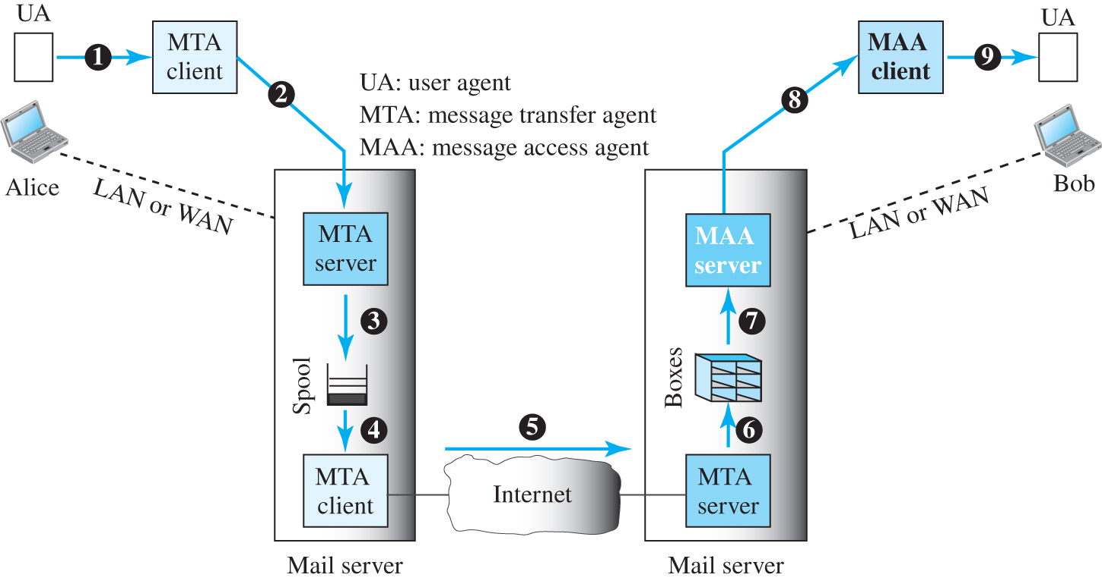
Email Architecture(Common scenario)
To explain the architecture of e-mail, a common scenario is shown in Figure 10.19.
Another possibility is the case in which Alice or Bob is directly connected to the corresponding mail server, in which LAN or WAN connection is not required.
Figure 10.19 Common scenario

Slide 99
UA(User Agent)
A user agent (UA) is a software package (program) that composes, reads, replies to, and forwards messages.
It is the first component of an electronic mail system.
It provides service to the user to make the process of sending and receiving a message easier.
It also handles local mailboxes on the user computers.
MTA (Mail Transfer Agent)
MTA (Mail Transfer Agent) is a crucial component responsible for routing and delivering email messages between servers.
MTA is software that handles the sending, receiving, and relaying of email messages.
It uses the SMTP (Simple Mail Transfer Protocol) to communicate with other MTAs.
MAA(Mail Access Agent)
MAA is an important component in the email architecture responsible for retrieving and managing email messages from the mail server for the end-user.
It interacts with the Mail Transfer Agent (MTA) to ensure that emails are accessed and managed properly.
Key Protocols Used by MAA: IMAP (Internet Message Access Protocol), POP3 (Post Office Protocol version 3

Slide 100
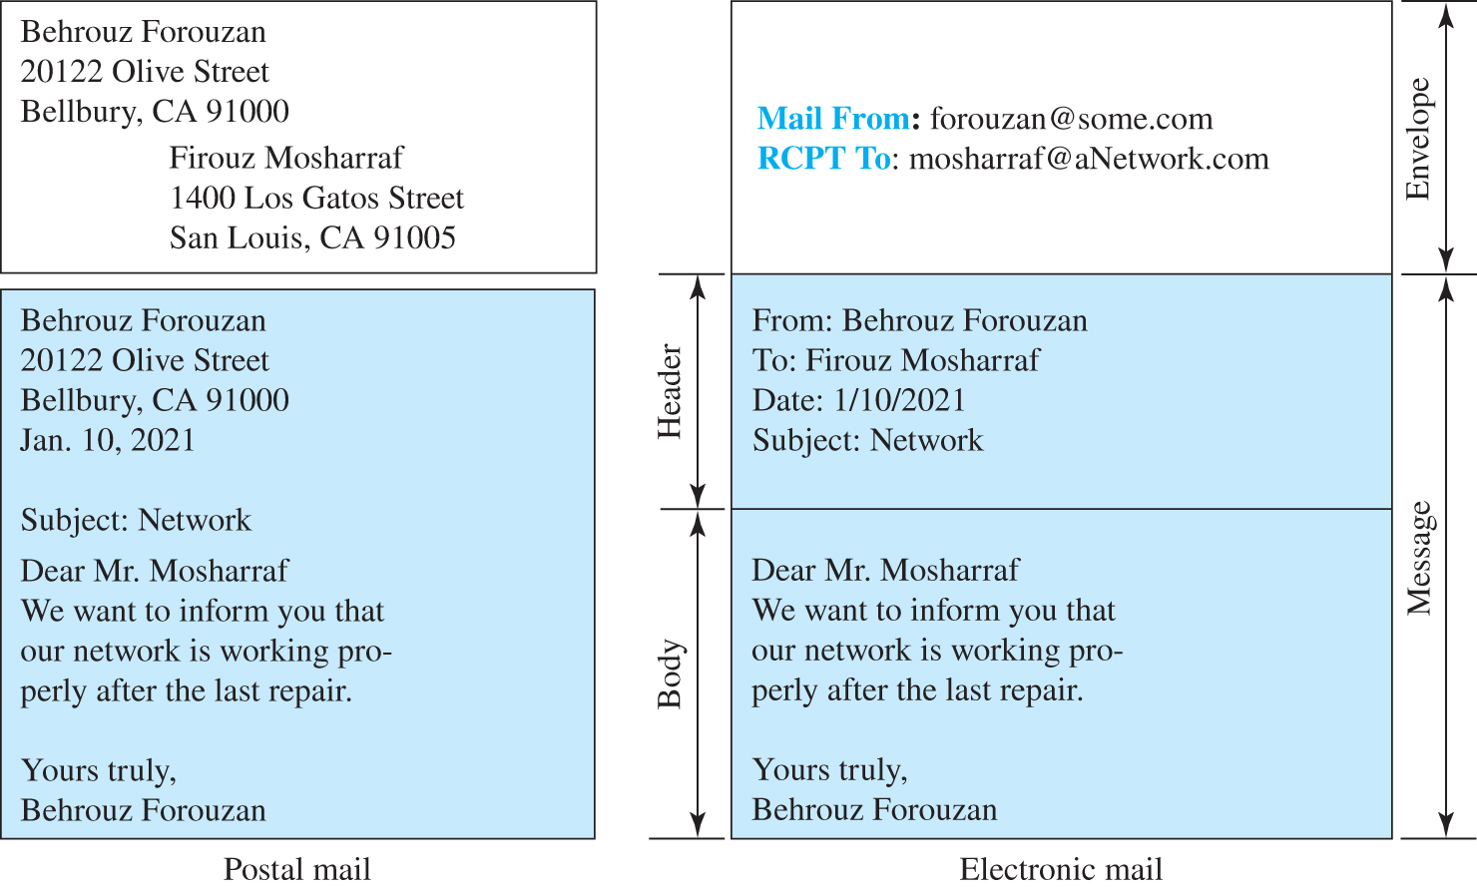
Figure 10.20 Format of an e-mail

Slide 101
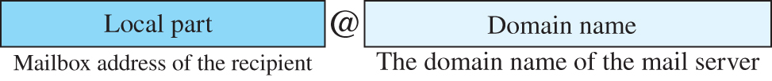
Figure 10.21 E-mail address
Access the text alternative for slide images.

Slide 102
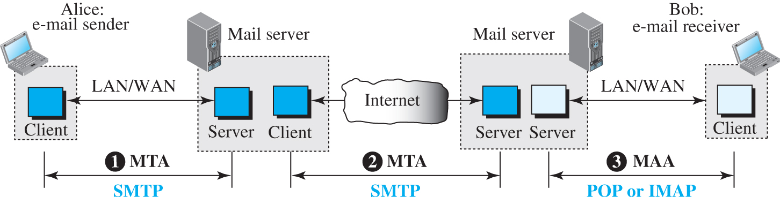
Protocols used in electronic mail
Based on the common scenario (Figure 10.19), we can say that the e-mail is one of those applications that needs three uses of client-server paradigms to accomplish its task.
It is important that we distinguish these three when we are dealing with e-mail.
Figure 10.22 shows these three client-server applications.
We refer to the first and the second as Message Transfer Agents (MTAs), the third as Message Access Agent (MAA).
Figure 10.22: Protocols used in electronic mail

Slide 103
SMTP (Simple Mail Transfer Protocol)
SMTP (Simple Mail Transfer Protocol) is the standard protocol used for sending emails across the Internet.
It operates on port 25 by default, although other ports like 587 or 465 are often used for encrypted communication.

Slide 104
How SMTP Works
Client Request: Your email client (like Outlook, Thunderbird, or a web-based service) sends a request to the SMTP server.
Server Authentication: The SMTP server authenticates the sender. This usually involves providing a username and password.
Message Transfer: The server processes the email, including recipient addresses, message content, and attachments.
Forwarding: The SMTP server then forwards the email to the recipient's SMTP server.
Delivery: The recipient's server uses a different protocol, like IMAP or POP3, to place the email into the recipient’s mailbox.

Slide 105
Table 10.6 SMTP commands
Keyword | Argument(s) | Description
HELO | Sender’s host name | Identifies itself
MAIL FROM | Sender of the message | Identifies the sender of the message
RCPT TO | Intended recipient | Identifies the recipient of the message
DATA | Body of the mail | Sends the actual message
QUIT |  | Terminates the message
RSET |  | Aborts the current mail transaction
VRFY | Name of recipient | Verifies the address of the recipient
NOOP |  | Checks the status of the recipient
TURN |  | Switches the sender and the recipient
EXPN | Mailing list | Asks the recipient to expand the mailing list
HELP | Command name | Asks the recipient to send information about the command sent as the argument
SEND FROM | Intended recipient | Specifies that the mail be delivered only to the terminal of the recipient, and not to the mailbox
SMOL FROM | Intended recipient | Specifies that the mail be delivered to the terminal or the mailbox of the recipient
SMAL FROM | Intended recipient | Specifies that the mail be delivered to the terminal and the mailbox of the recipient

Slide 106
Table 10.7 SMTP responses 1
Code | Description
 | Positive Completion Reply
211 | System status or help reply
214 | Help message
220 | Service ready
221 | Service closing transmission channel
250 | Request command completed
251 | User not local; the message will be forwarded
 | Positive Intermediate Reply
354 | Start mail input
 | Transient Negative Completion Reply
421 | Service not available
450 | Mailbox not available
451 | Command aborted: local error
452 | Command aborted; insufficient storage

Slide 107
Table 10.7 SMTP responses 2
 | Permanent Negative Completion Reply
500 | Syntax error; unrecognized command
501 | Syntax error in parameters or arguments
502 | Command not implemented
503 | Bad sequence of commands
504 | Command temporarily not implemented
550 | Command is not executed; mailbox unavailable
551 | User not local
552 | Requested action aborted; exceeded storage location
553 | Requested action not taken; mailbox name not allowed
554 | Transaction failed

Slide 108
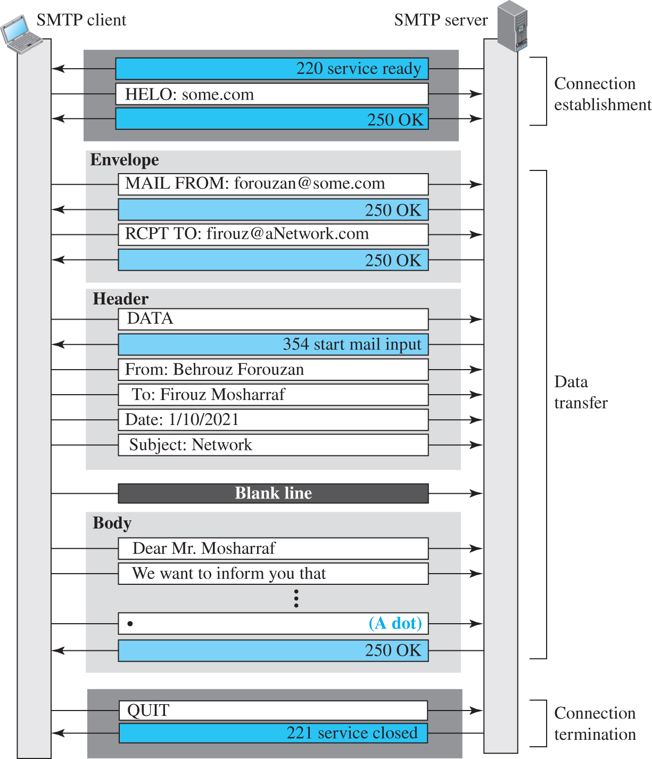
Figure 10.23 Example 10.13
Figure 10.23 show the three mail transfer phases.
In the figure, we have separated the messages related to the envelope, header, and body in the data transfer section.
Note that the steps in this figure are repeated two times in each e-mail transfer: once from the e-mail sender to the local mail server and once from the local mail server to the remote mail server.
The local mail server, after receiving the whole e-mail message, may spool it and send it to the remote mail server at another time.
Access the text alternative for slide images.

Slide 109
Message Access Agent: POP and IMAP
The first and second stages of mail delivery use SMTP. However, SMTP is not involved in the third stage because SMTP is a push protocol; it pushes the message from the client to the server. In other words, the direction of the bulk data (messages) is from the client to the server.
On the other hand, the third stage needs a pull protocol; the client must pull messages from the server. The direction of the bulk data is from the server to the client. The third stage uses a message access agent.

Slide 110
POP3 (Post Office Protocol version 3)
Function: Downloads email from the server to the local client, typically removing it from the server after retrieval.
Features: Simple protocol primarily used for downloading emails; lacks advanced features like folder management.
Port: Typically uses port 110 for unencrypted connections and port 995 for encrypted (SSL/TLS) connections.

Slide 111
IMAP (Internet Message Access Protocol)
Function: Allows clients to access and manage email on the server while keeping messages on the server.
Features: Supports folder management, searching, and synchronization across multiple devices.
Port: Typically uses port 143 for unencrypted connections and port 993 for encrypted (SSL/TLS) connections.

Slide 112
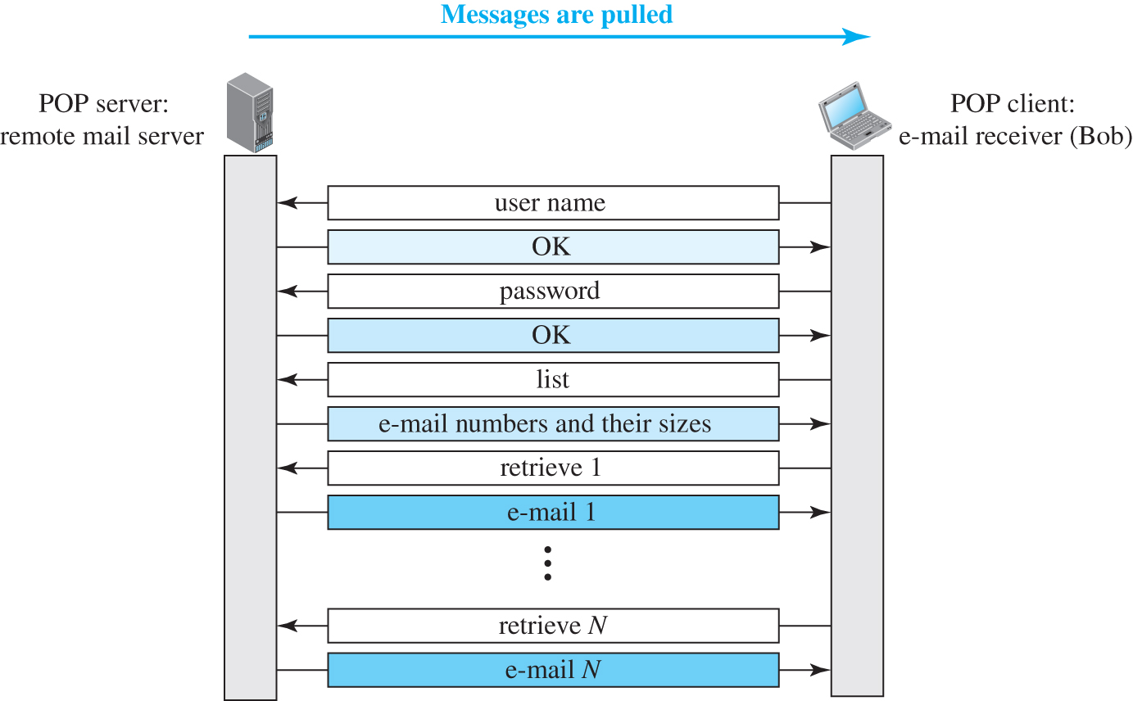
Figure 10.24 POP3
Access the text alternative for slide images.

Slide 113
MIME
Electronic mail has a simple structure. Its simplicity, however, comes with a price. It can send messages only in NVT 7-bit ASCII format. In other words, it has some limitations. It cannot be used for languages other than English (such as French, German, Hebrew, Russian, Chinese, and Japanese). Also, it cannot be used to send binary files or video or audio data.
Multipurpose Internet Mail Extensions (MIME) is a supplementary protocol that allows non-ASCII data to be sent through e-mail.

Slide 114

Figure 10.25 MIME
Access the text alternative for slide images.

Slide 115

Figure 10.26 MIME header
Access the text alternative for slide images.

Slide 116
Table 10.8 Data types and subtypes in MIME
Type | Subtype | Description
Text | Plain | Unformatted
 | HTML | HTML format (see Appendix C)
 | Mixed | Body contains ordered parts of different data types
Multipart | Parallel | Same as above, but no order
 | Digest | Similar to Mixed, but the default is message/RFC822
 | Alternative | Parts are different versions of the same message
 | RFC822 | Body is an encapsulated message
Message | Partial | Body is a fragment of a bigger message
 | External-Body | Body is a reference to another message
Image | JPEG | Image is in JPEG format
 | GIF | Image is in GIF format
Video | MPEG | Video is in MPEG format
Audio | Basic | Single channel encoding of voice at 8 kHz
Application | PostScript | Adobe PostScript
 | Octet-stream | General binary data (8-bit bytes)

Slide 117
Table 10.9 Methods for content-transfer-encoding
Type | Description
7-bit | NVT ASCII characters with each line less than 1000 characters
8-bit | Non-ASCII characters with each line less than 1000 characters
Binary | Non-ASCII characters with unlimited-length lines
Base64 | 6-bit blocks of data encoded into 8-bit ASCII characters
Quoted-printable | Non-ASCII characters encoded as an equal sign plus an ASCII code

